Slide 1
Santreva-ATK
First-in-Human Case in Paraguay

Slide 2
Case Summary
86 year old female with Hx of HTN, CAD, Non-diabetic and non-smoker
Bilateral SFA occlusions with critical limb ischemia
Rutherford 6 on both legs (non-healing ischemic ulcers on toes, rest pains for several months)
Left SFA CTO 14cm with moderate calcification
Very poor distal runoff.
Successfully revascularized with Santreva-ATK with a 10 min crossing time
Improved pedal flow

Slide 3
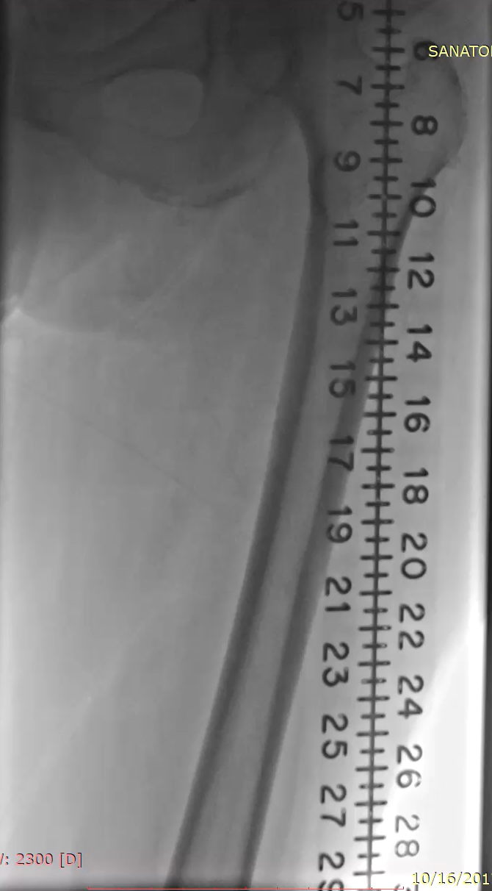
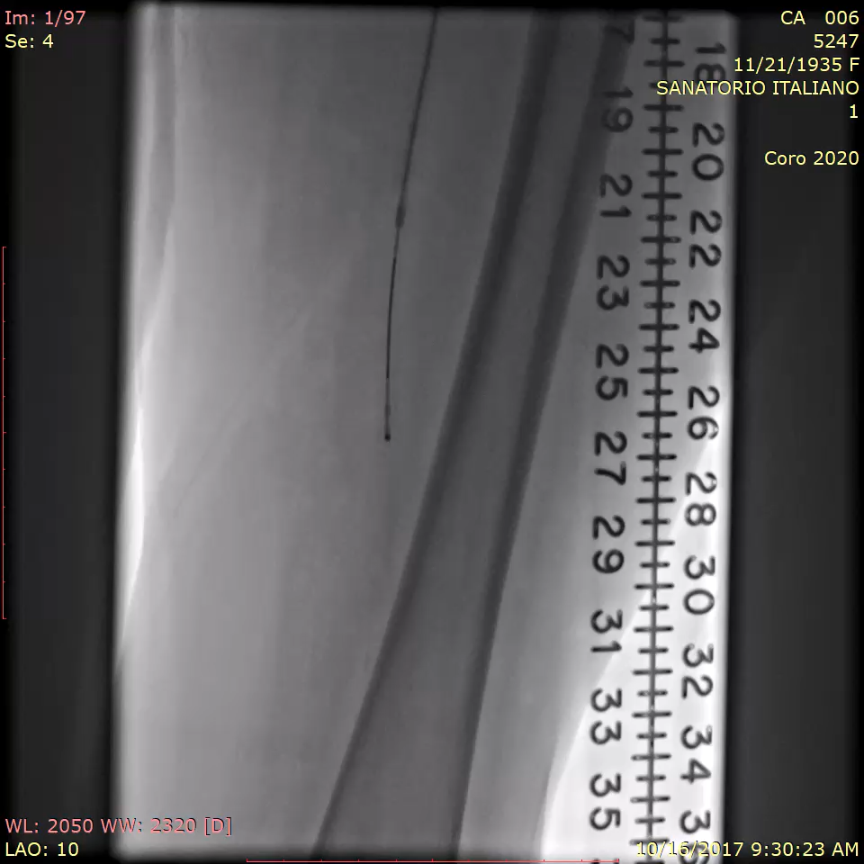
Baseline Angiogram with Mid SFA CTO and Santreva ATK crossing the CTO

Slide 4
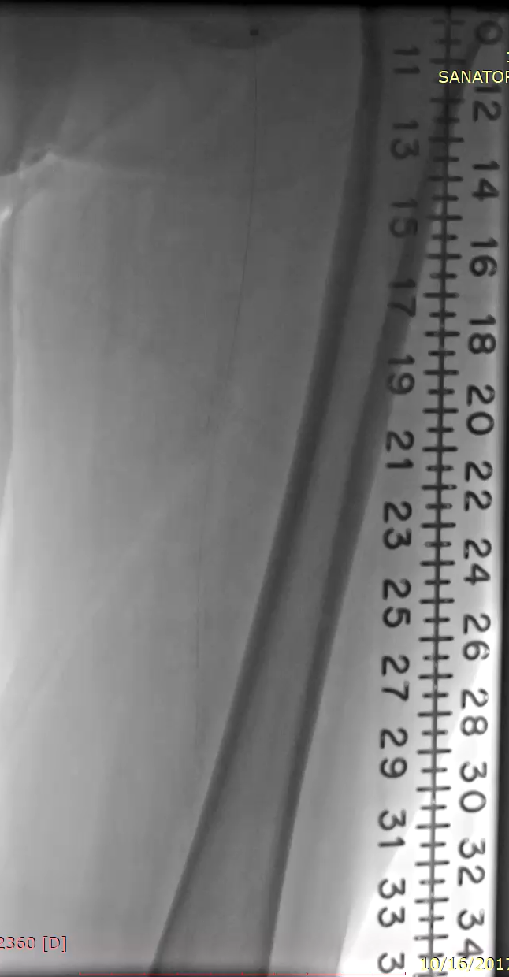
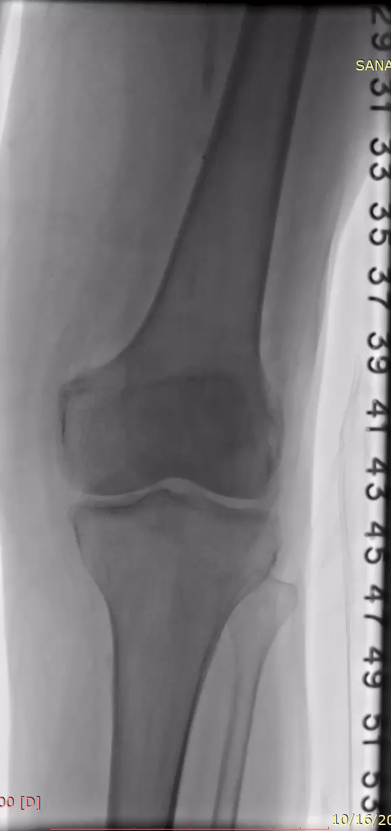
Recanalized SFA Channel post Santreva-ATK crossing

Slide 5
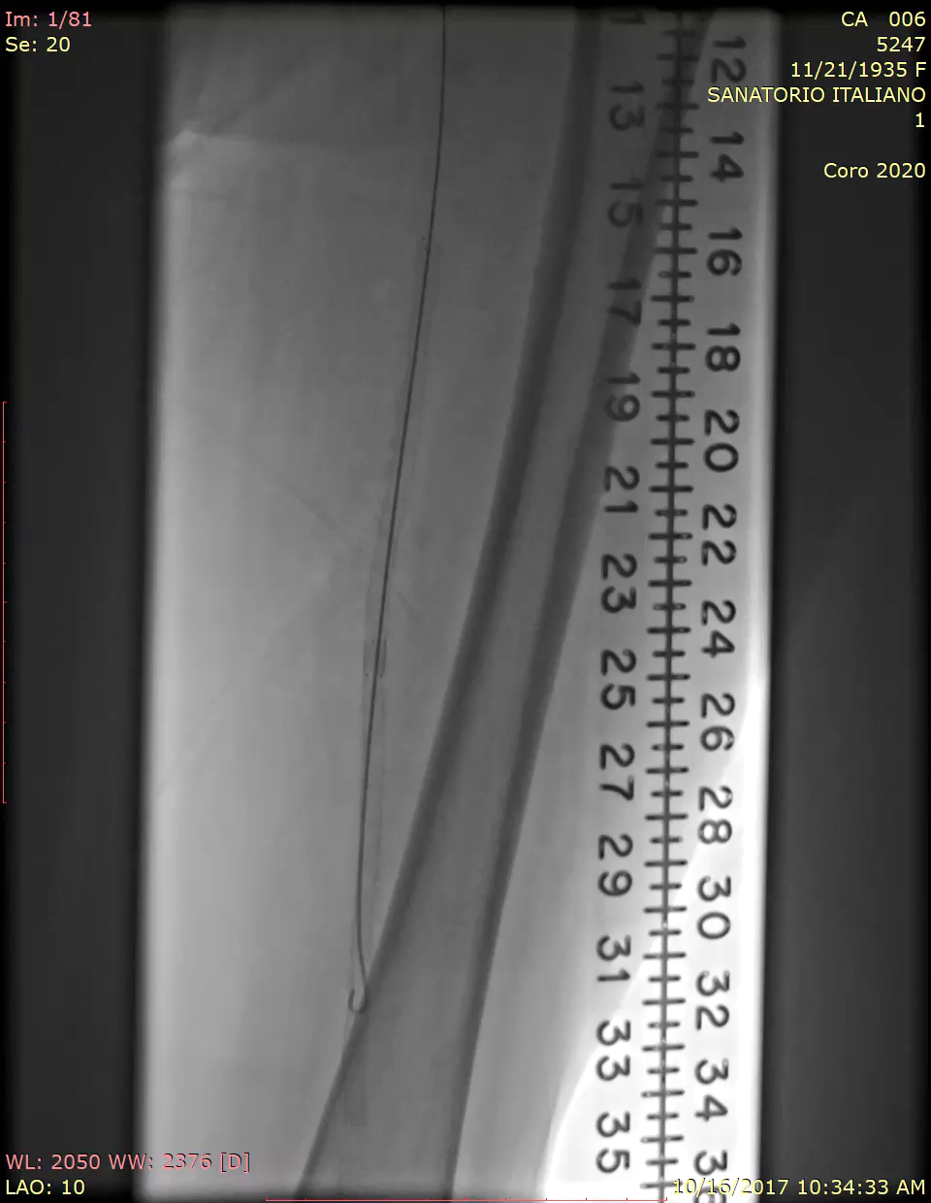
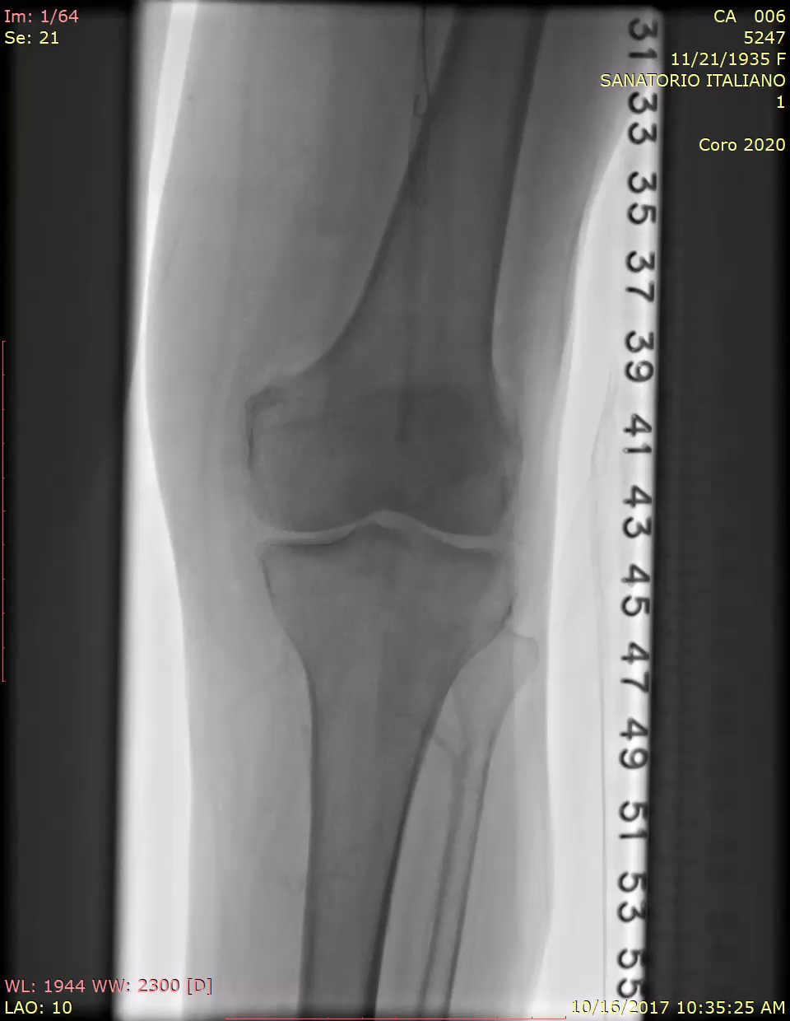
Final Result post PTA and SFA stenting with improved distal flow

Slide 6
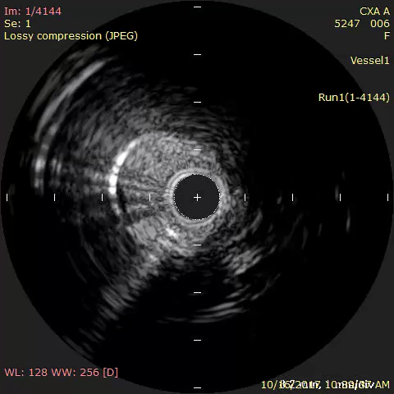
IVUS showing Intraluminal SFA Crossing

