Slide 1
PATIENT DEMOGRAPHICS
58 Y/O Female all the usual risk factors
Rutherford 3 progressing to R4 with some pain at rest
Imaging performed: Duplex
  Left Popliteal occlusion; 80-100cm
  Distal SFA diffusely diseased
Plan revascularize the popliteal to relieve rest pain, had multiple prior rounds of restenosis.
Planning to stent given restenosis/occlusion
Courtesy of Dr Matthew Finn

Slide 2
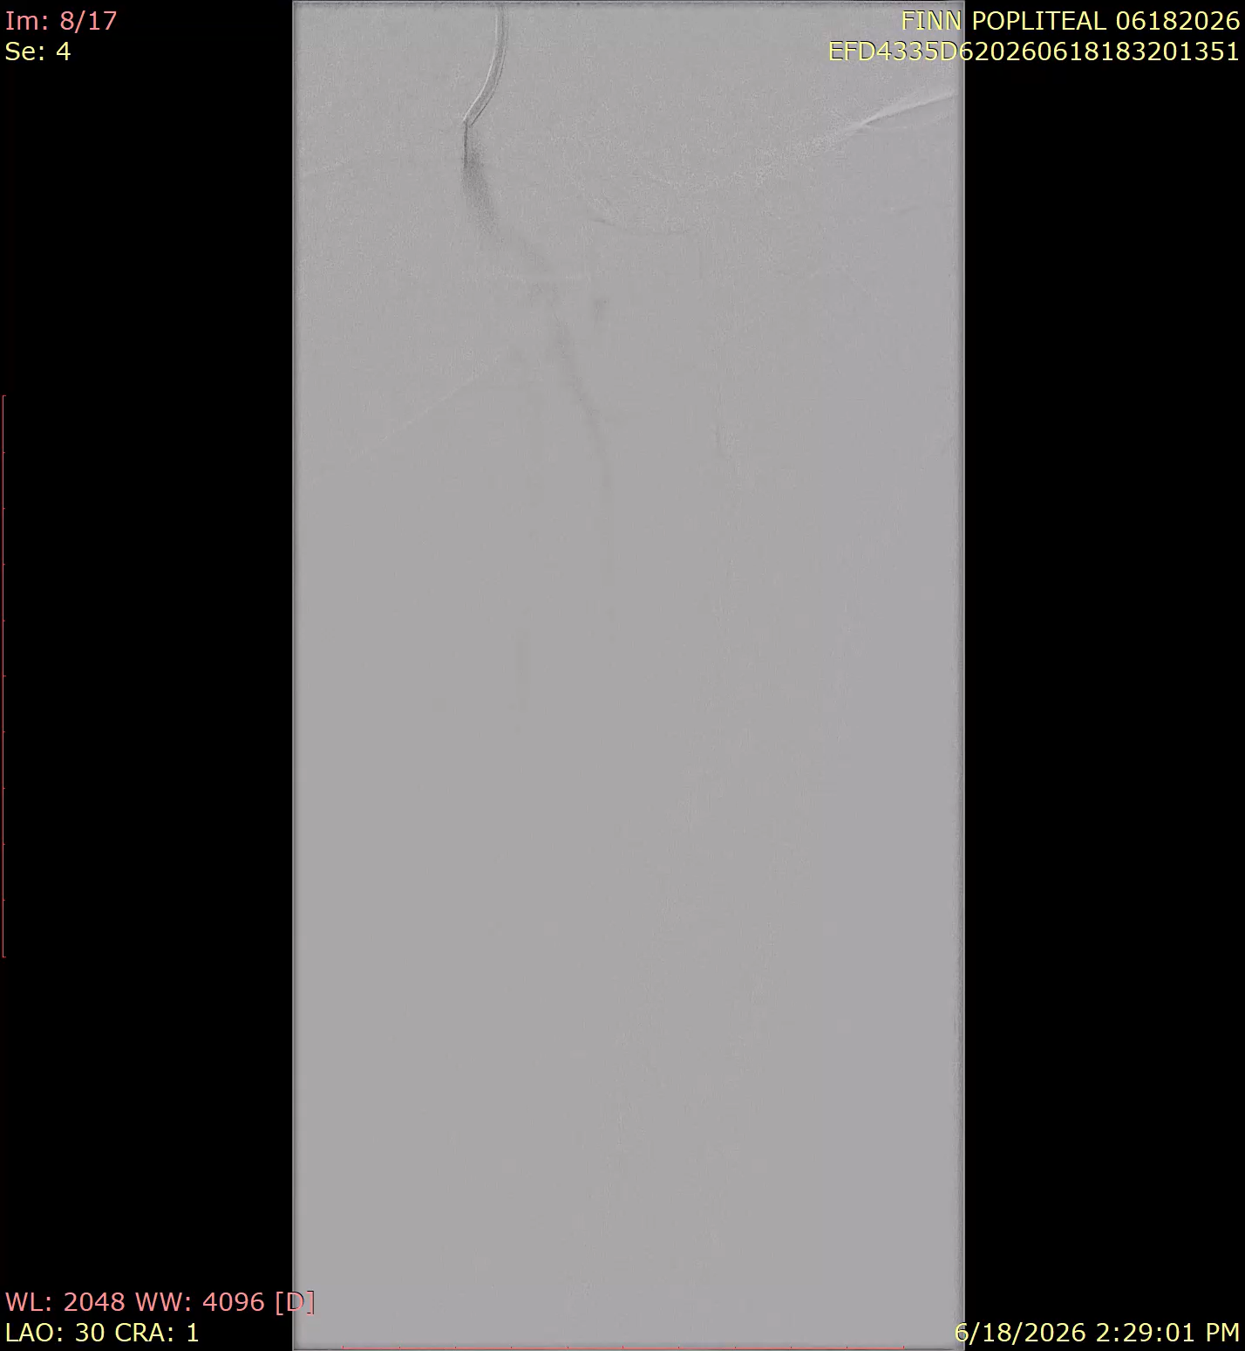
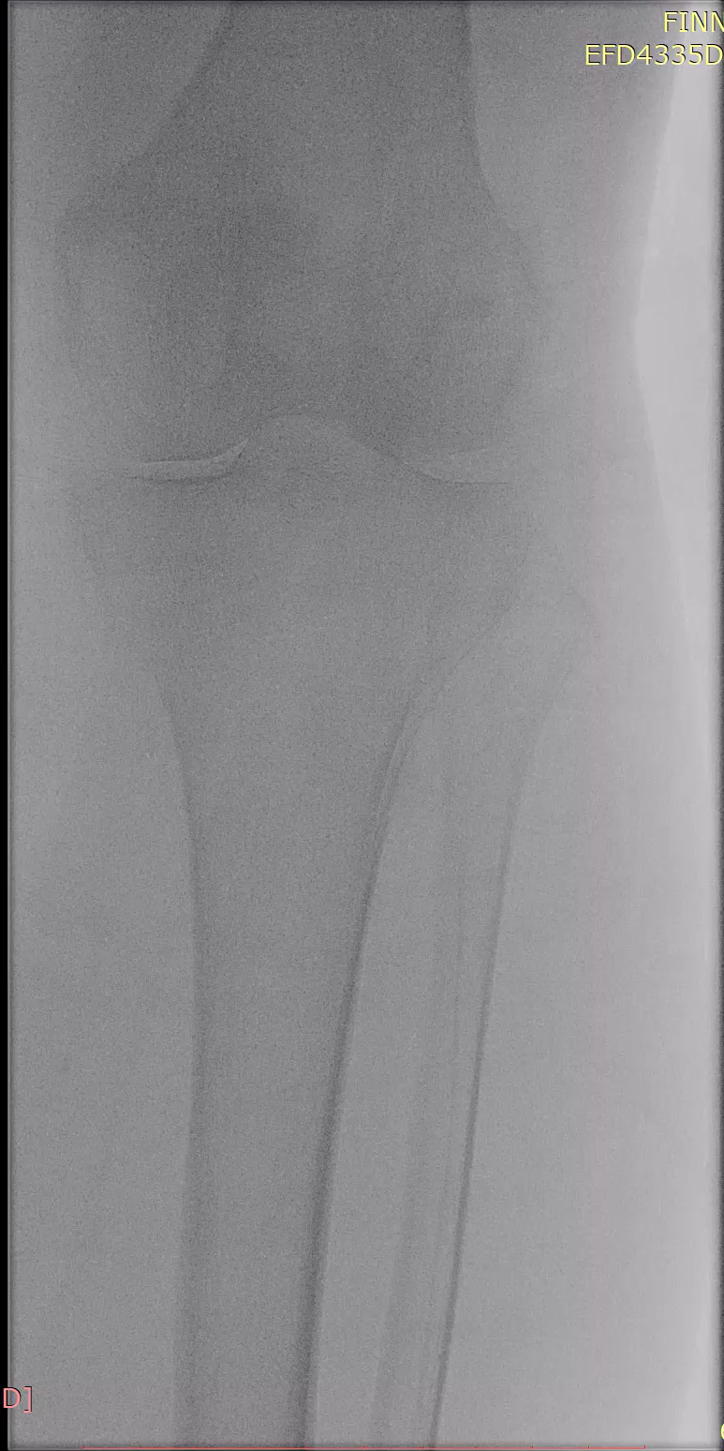
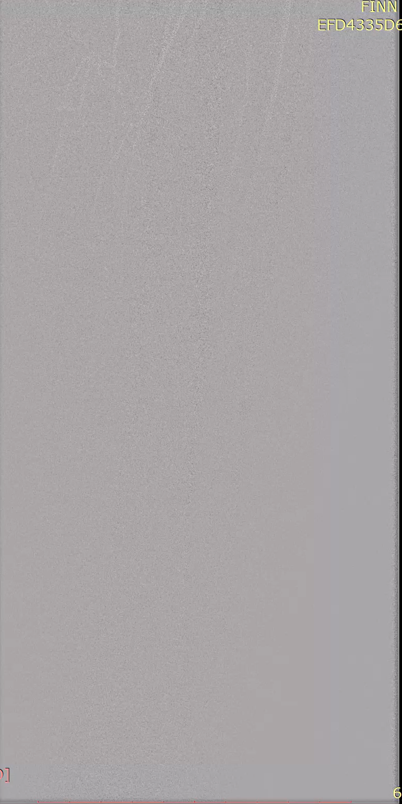
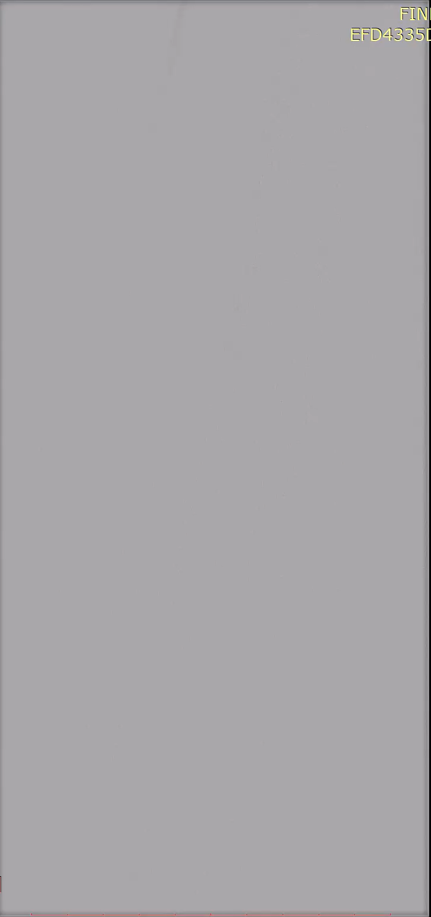
Baseline Angiography with occluded Popliteal

Slide 3
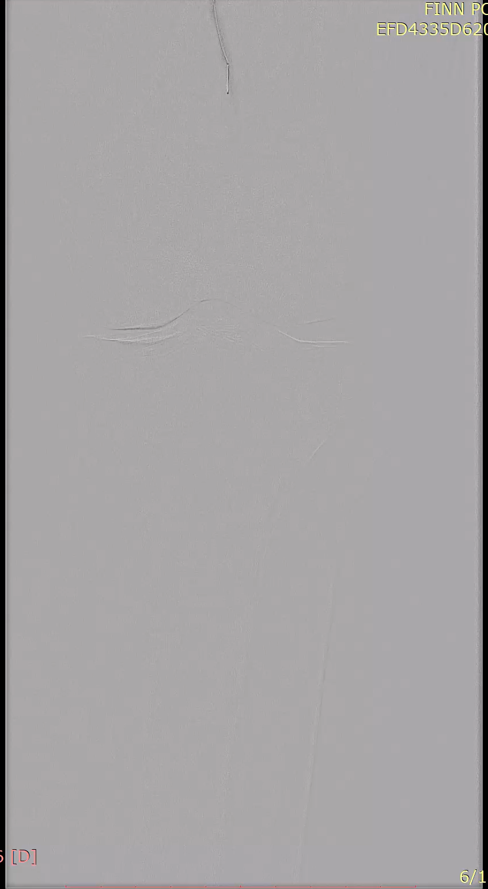
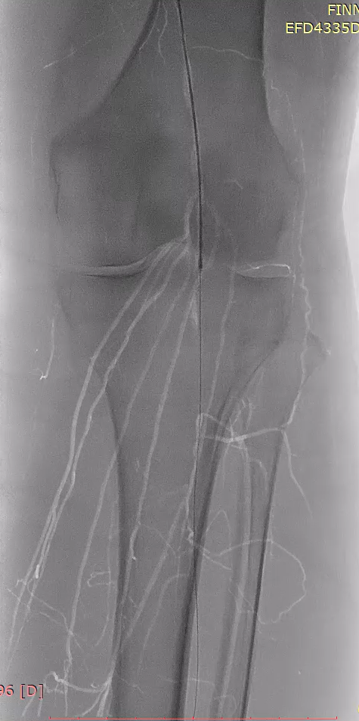
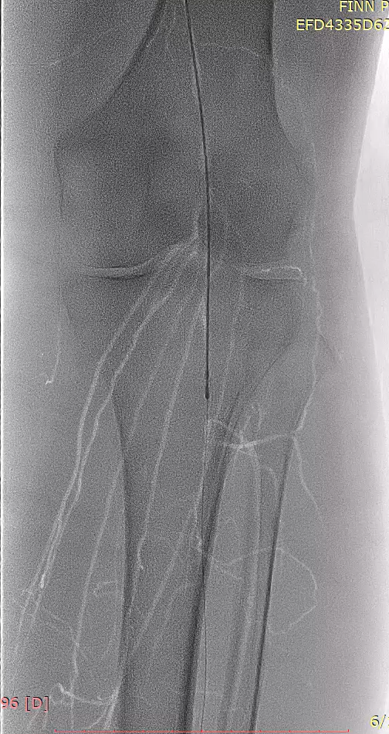
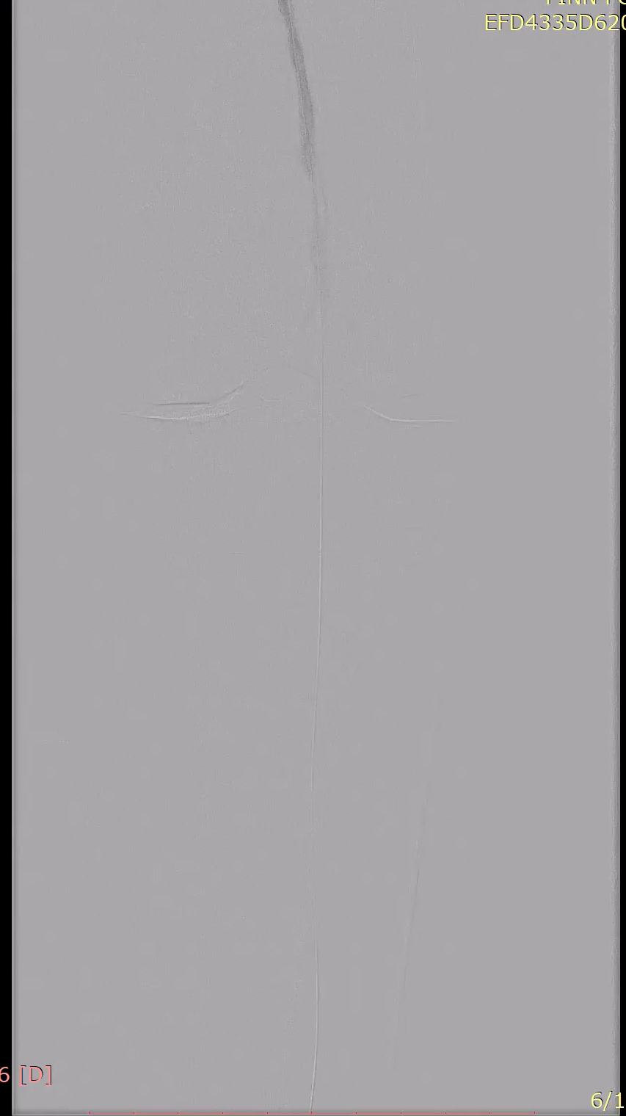
Santreva Crossing and Additional passes Creating a Channel

Slide 4
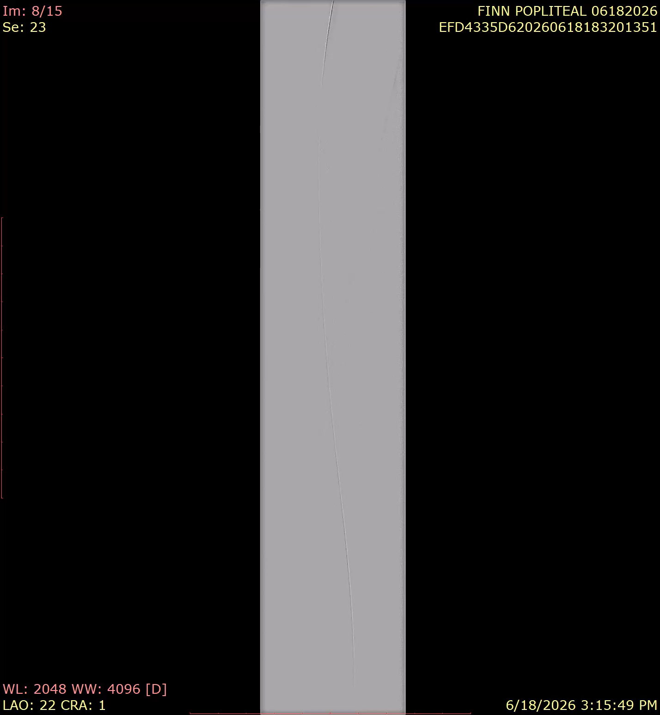
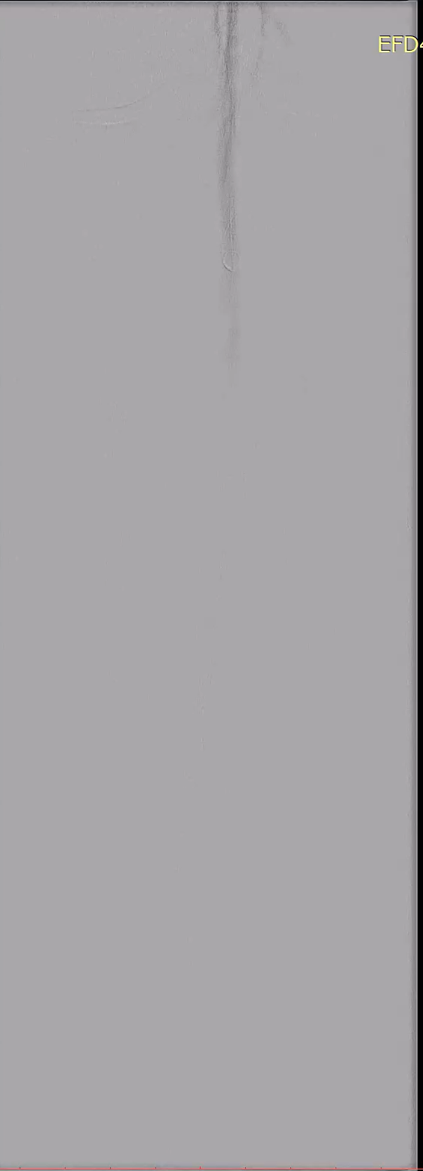
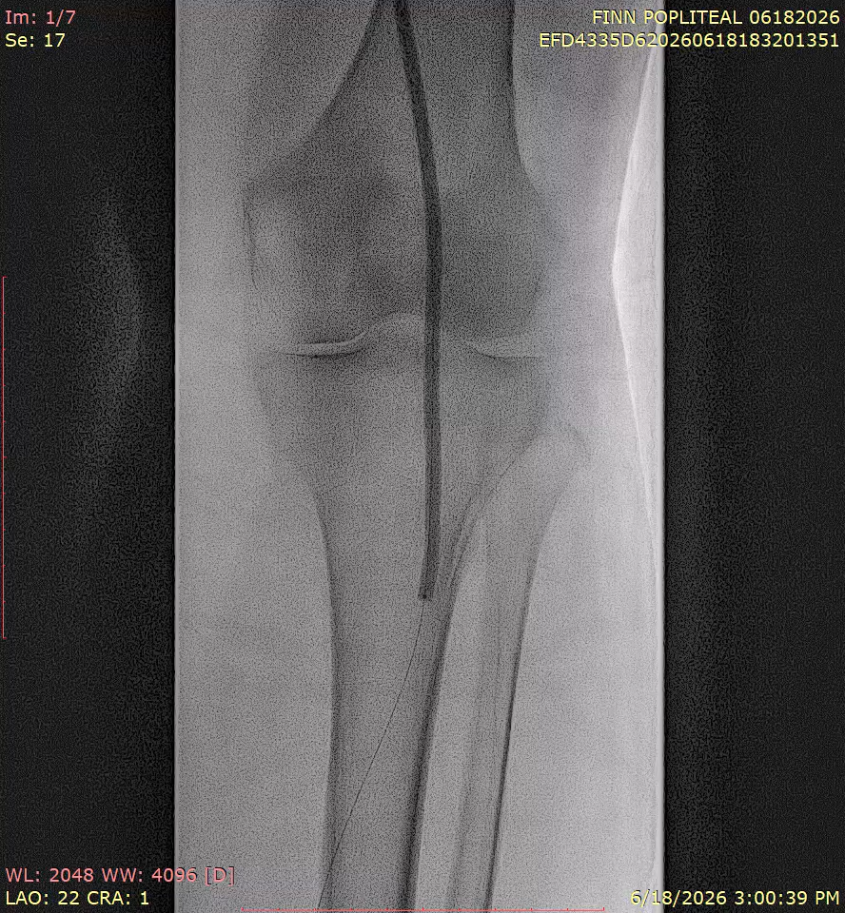
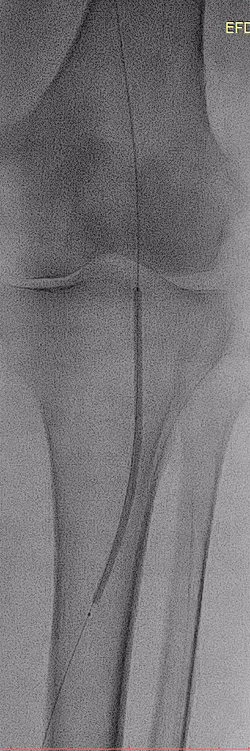
PTA of Popliteal into the Tibial and Final Result
Notes:
4.0 and 3.0 mm balloons, 6.0 mm balloon more poximally

Slide 5
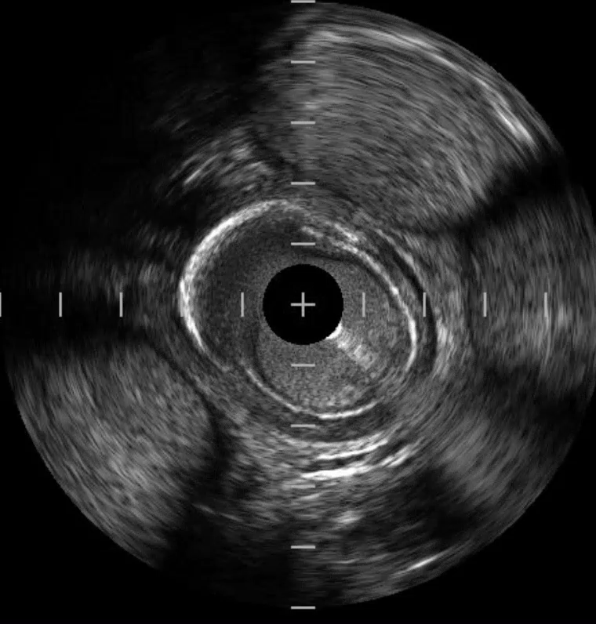
Imaging shows Intraplaque crossing

