Slide 1
PATIENT DEMOGRAPHICS
51 Y/O Female current heavy smoker
Rutherford Class 4/ rest pain in both legs
  Duplex with bilateral CFA disease and long segment bilateral SFA occlusions
Pt agreed to proceed to angiography
  Plan to try to avoid stenting due to the small size of the Superficial Femoral Arteries
Case one: LT SFA; Case two: RT SFA
Courtesy Dr. Matthew Finn

Slide 2
LEFT SFA

Slide 3
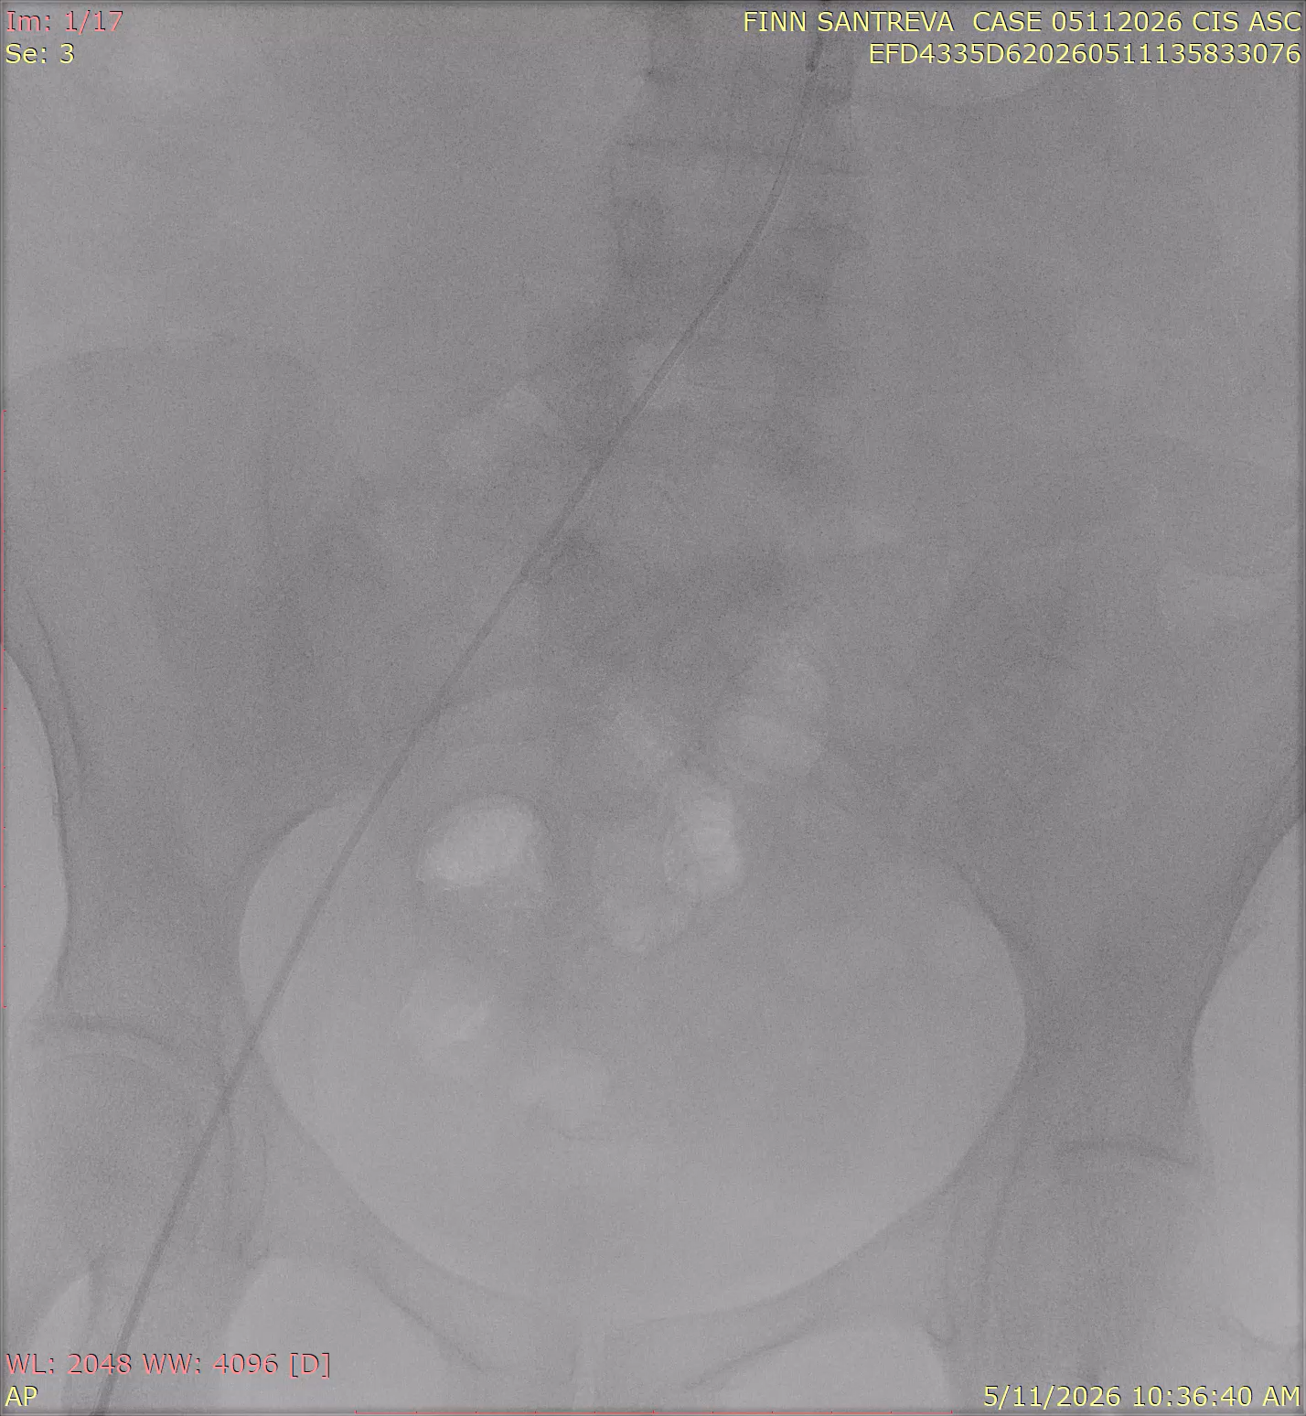
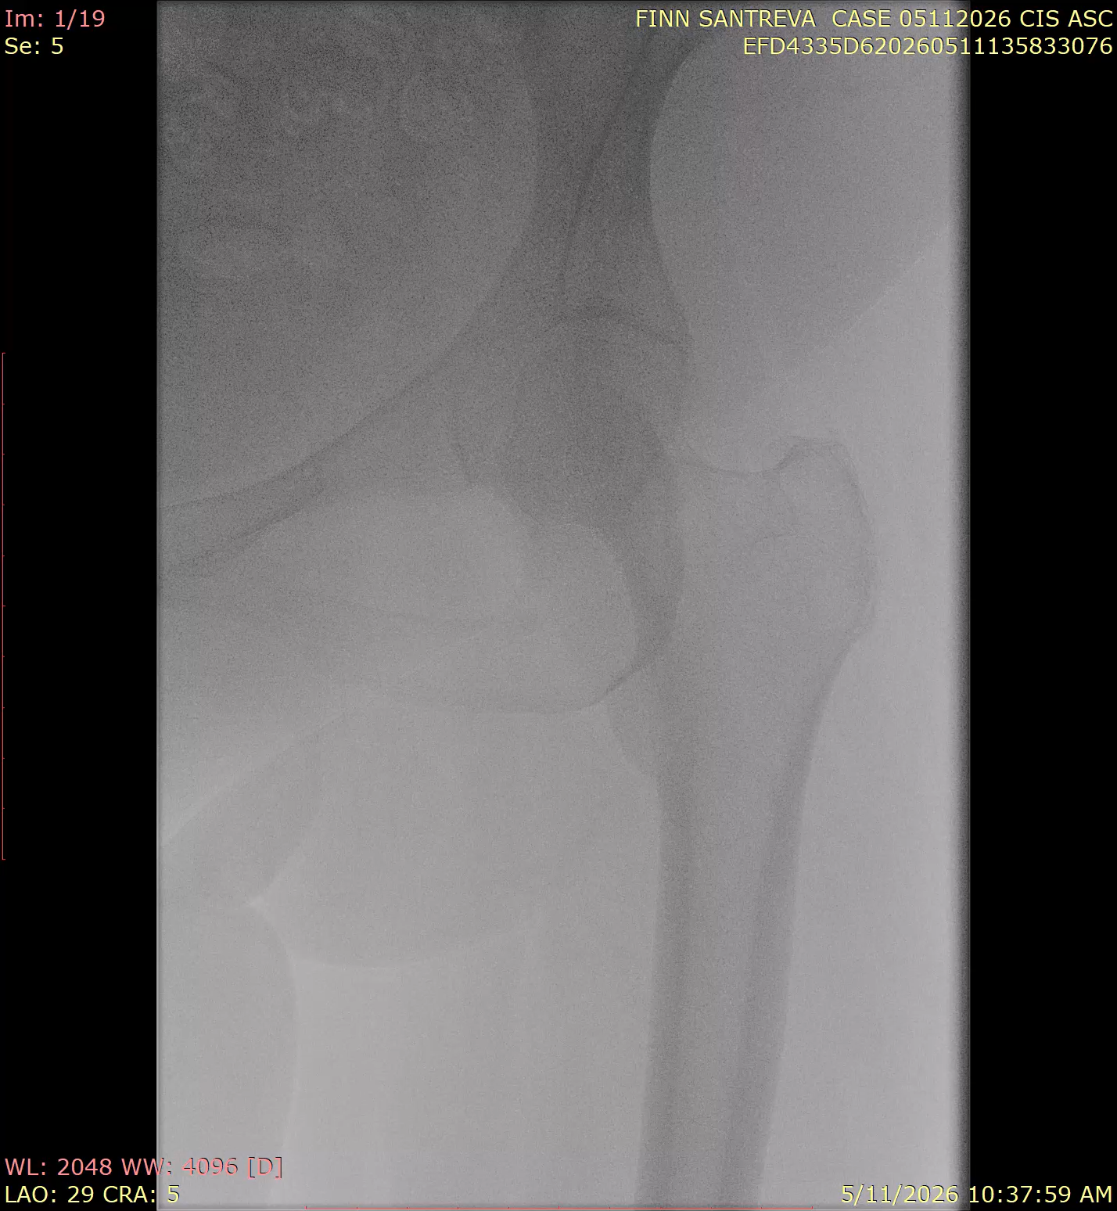
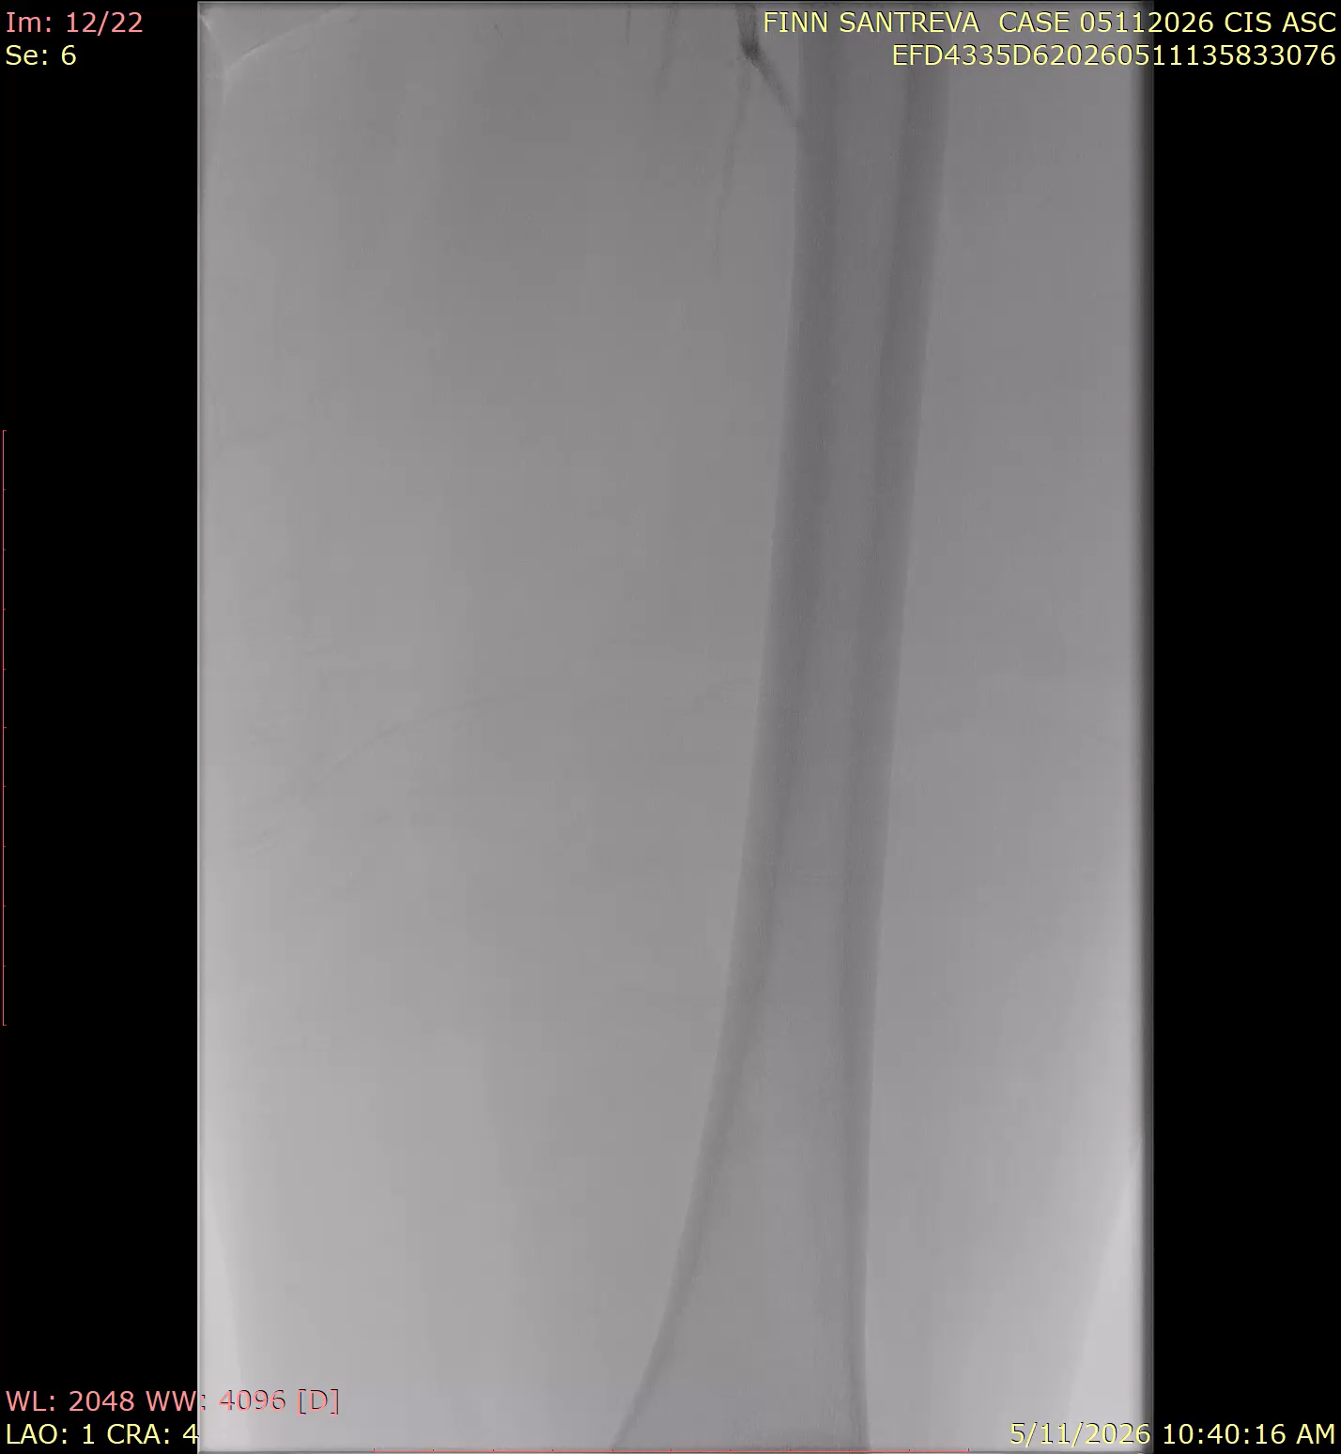
Diseased Iliacs &Occluded Left CFA and SFA

Slide 4
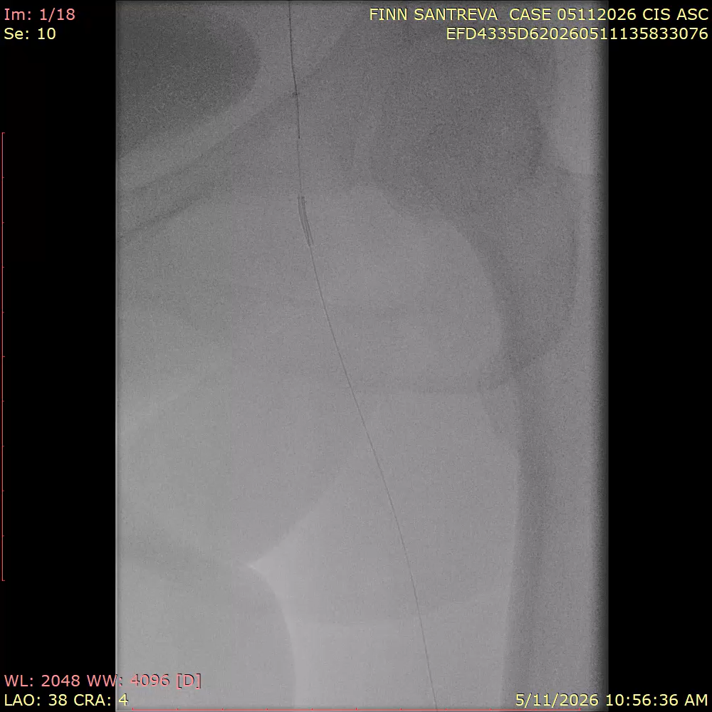
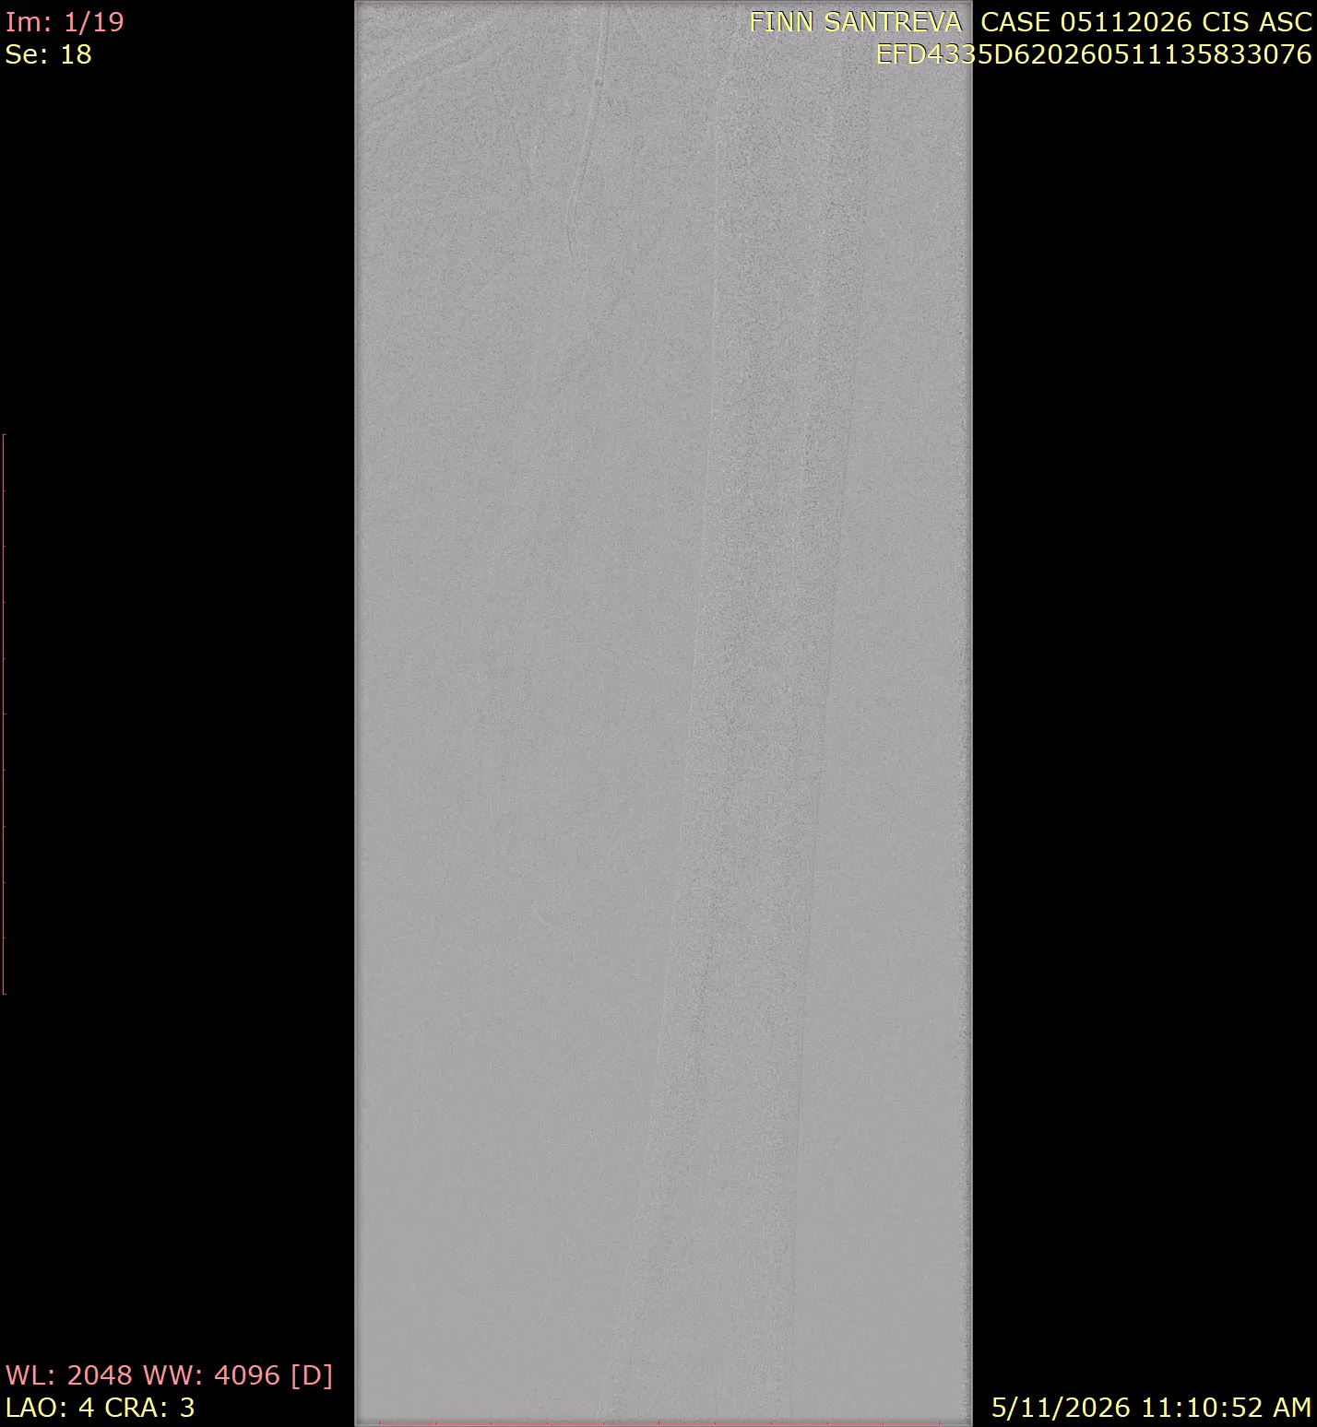
Revascularized the Iliac and CFA and proceeding to the SFA

Slide 5
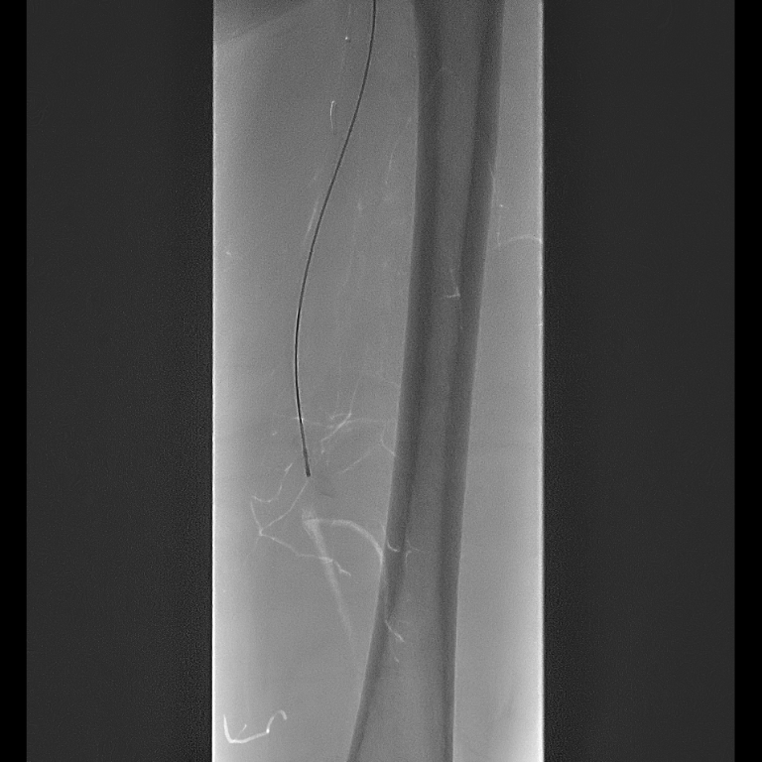
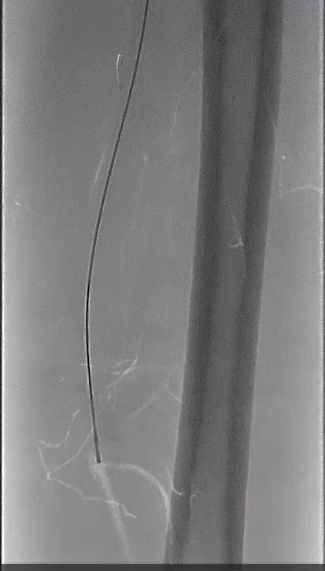
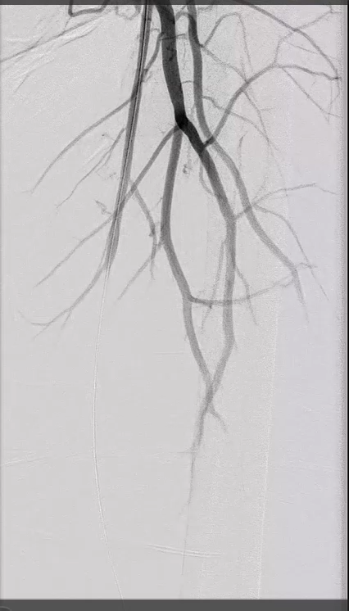
Intraprocedural Imaging
SANTREVA CROSSING SFA CTO
SANTREVA CHANNEL CREATION
Notes:
Santreva with a Grandslam wire
SFA crossing
Santreva Cap to Cap crossing 9 mins
4x150 PTA/4x150 DCB

Slide 6
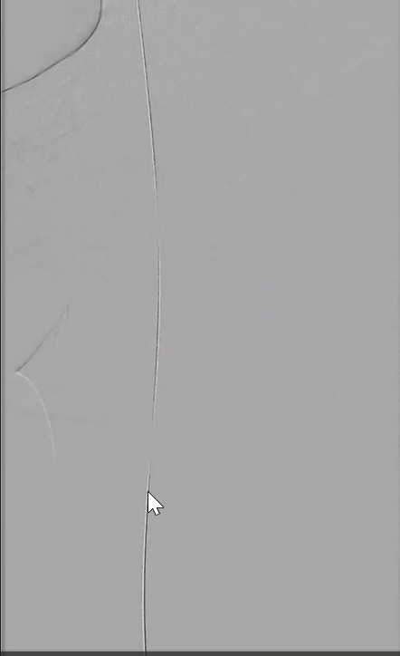
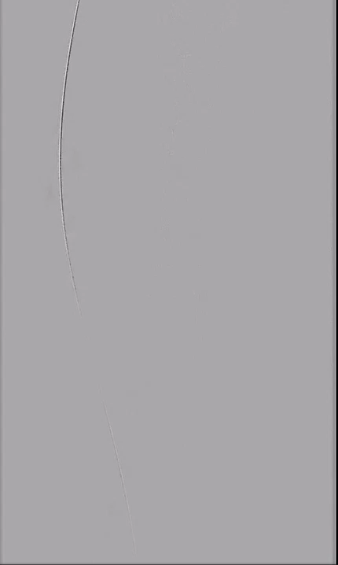
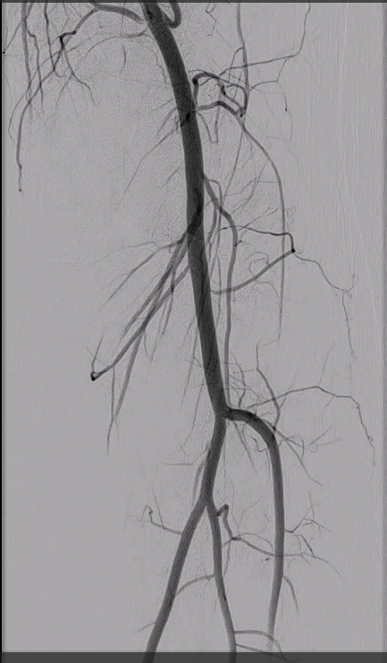
Final Result

Slide 7
SECOND CASE RIGHT SFA

Slide 8
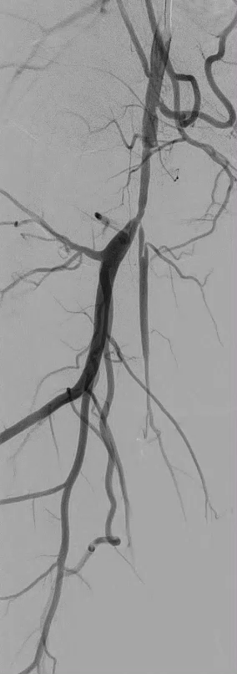
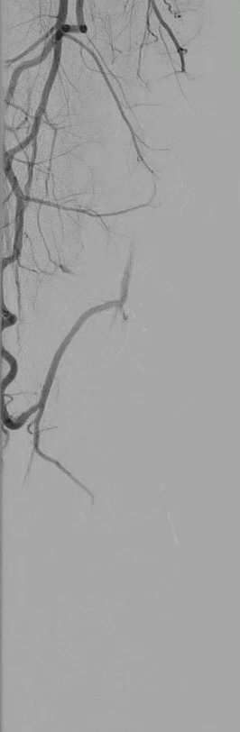
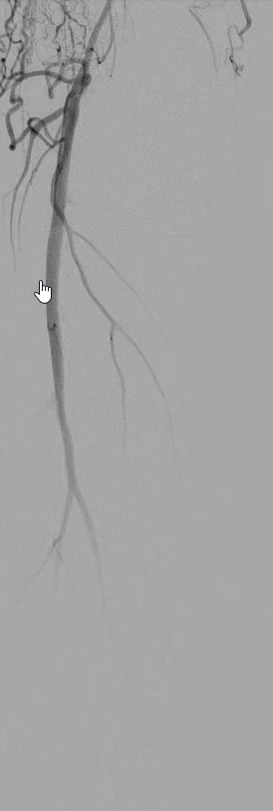
Intraprocedural Imaging
SFA LESION & SECOND CTO IN POPLITEAL

Slide 9
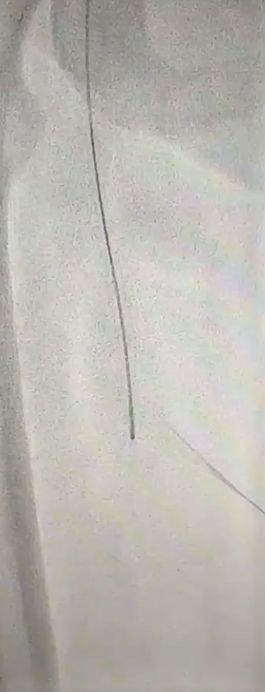
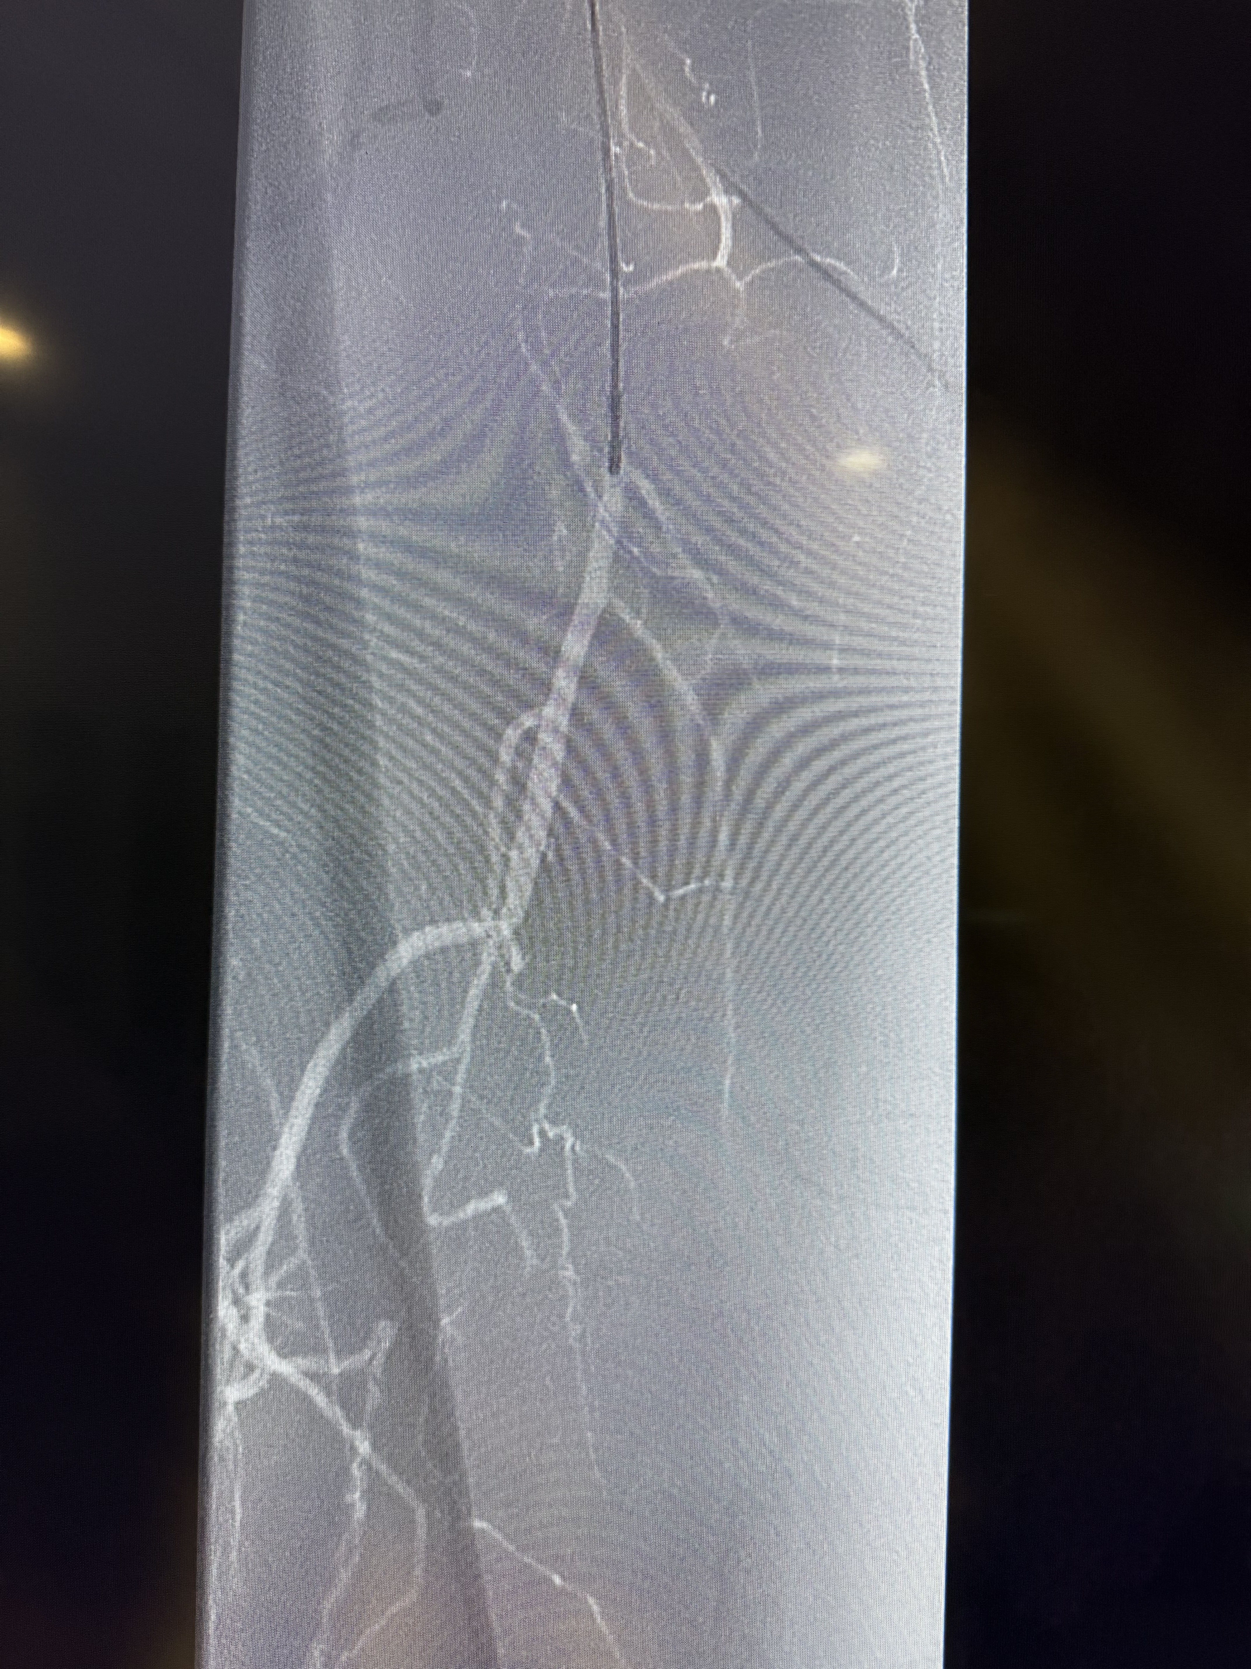
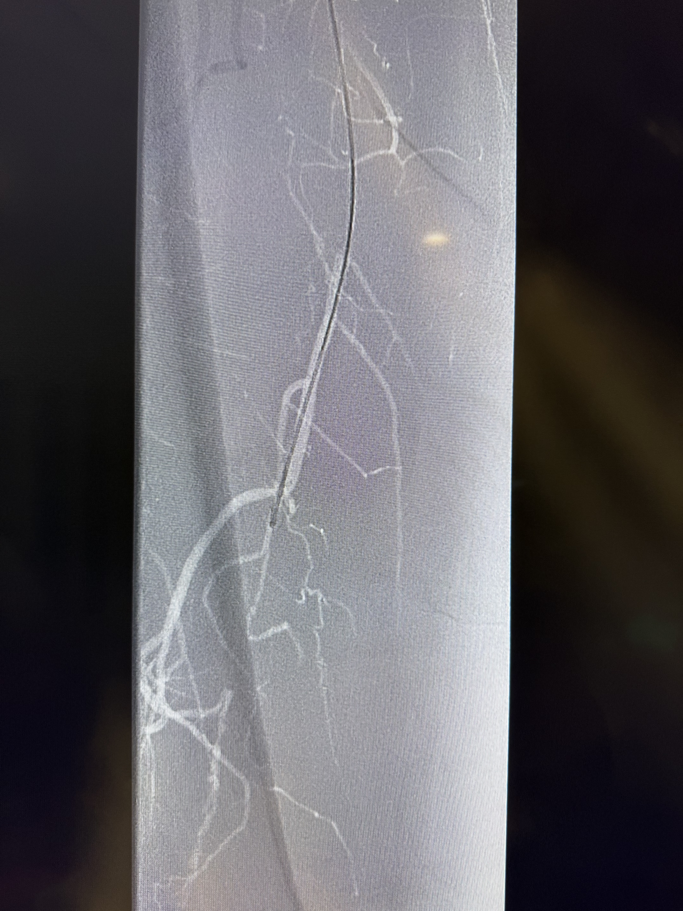
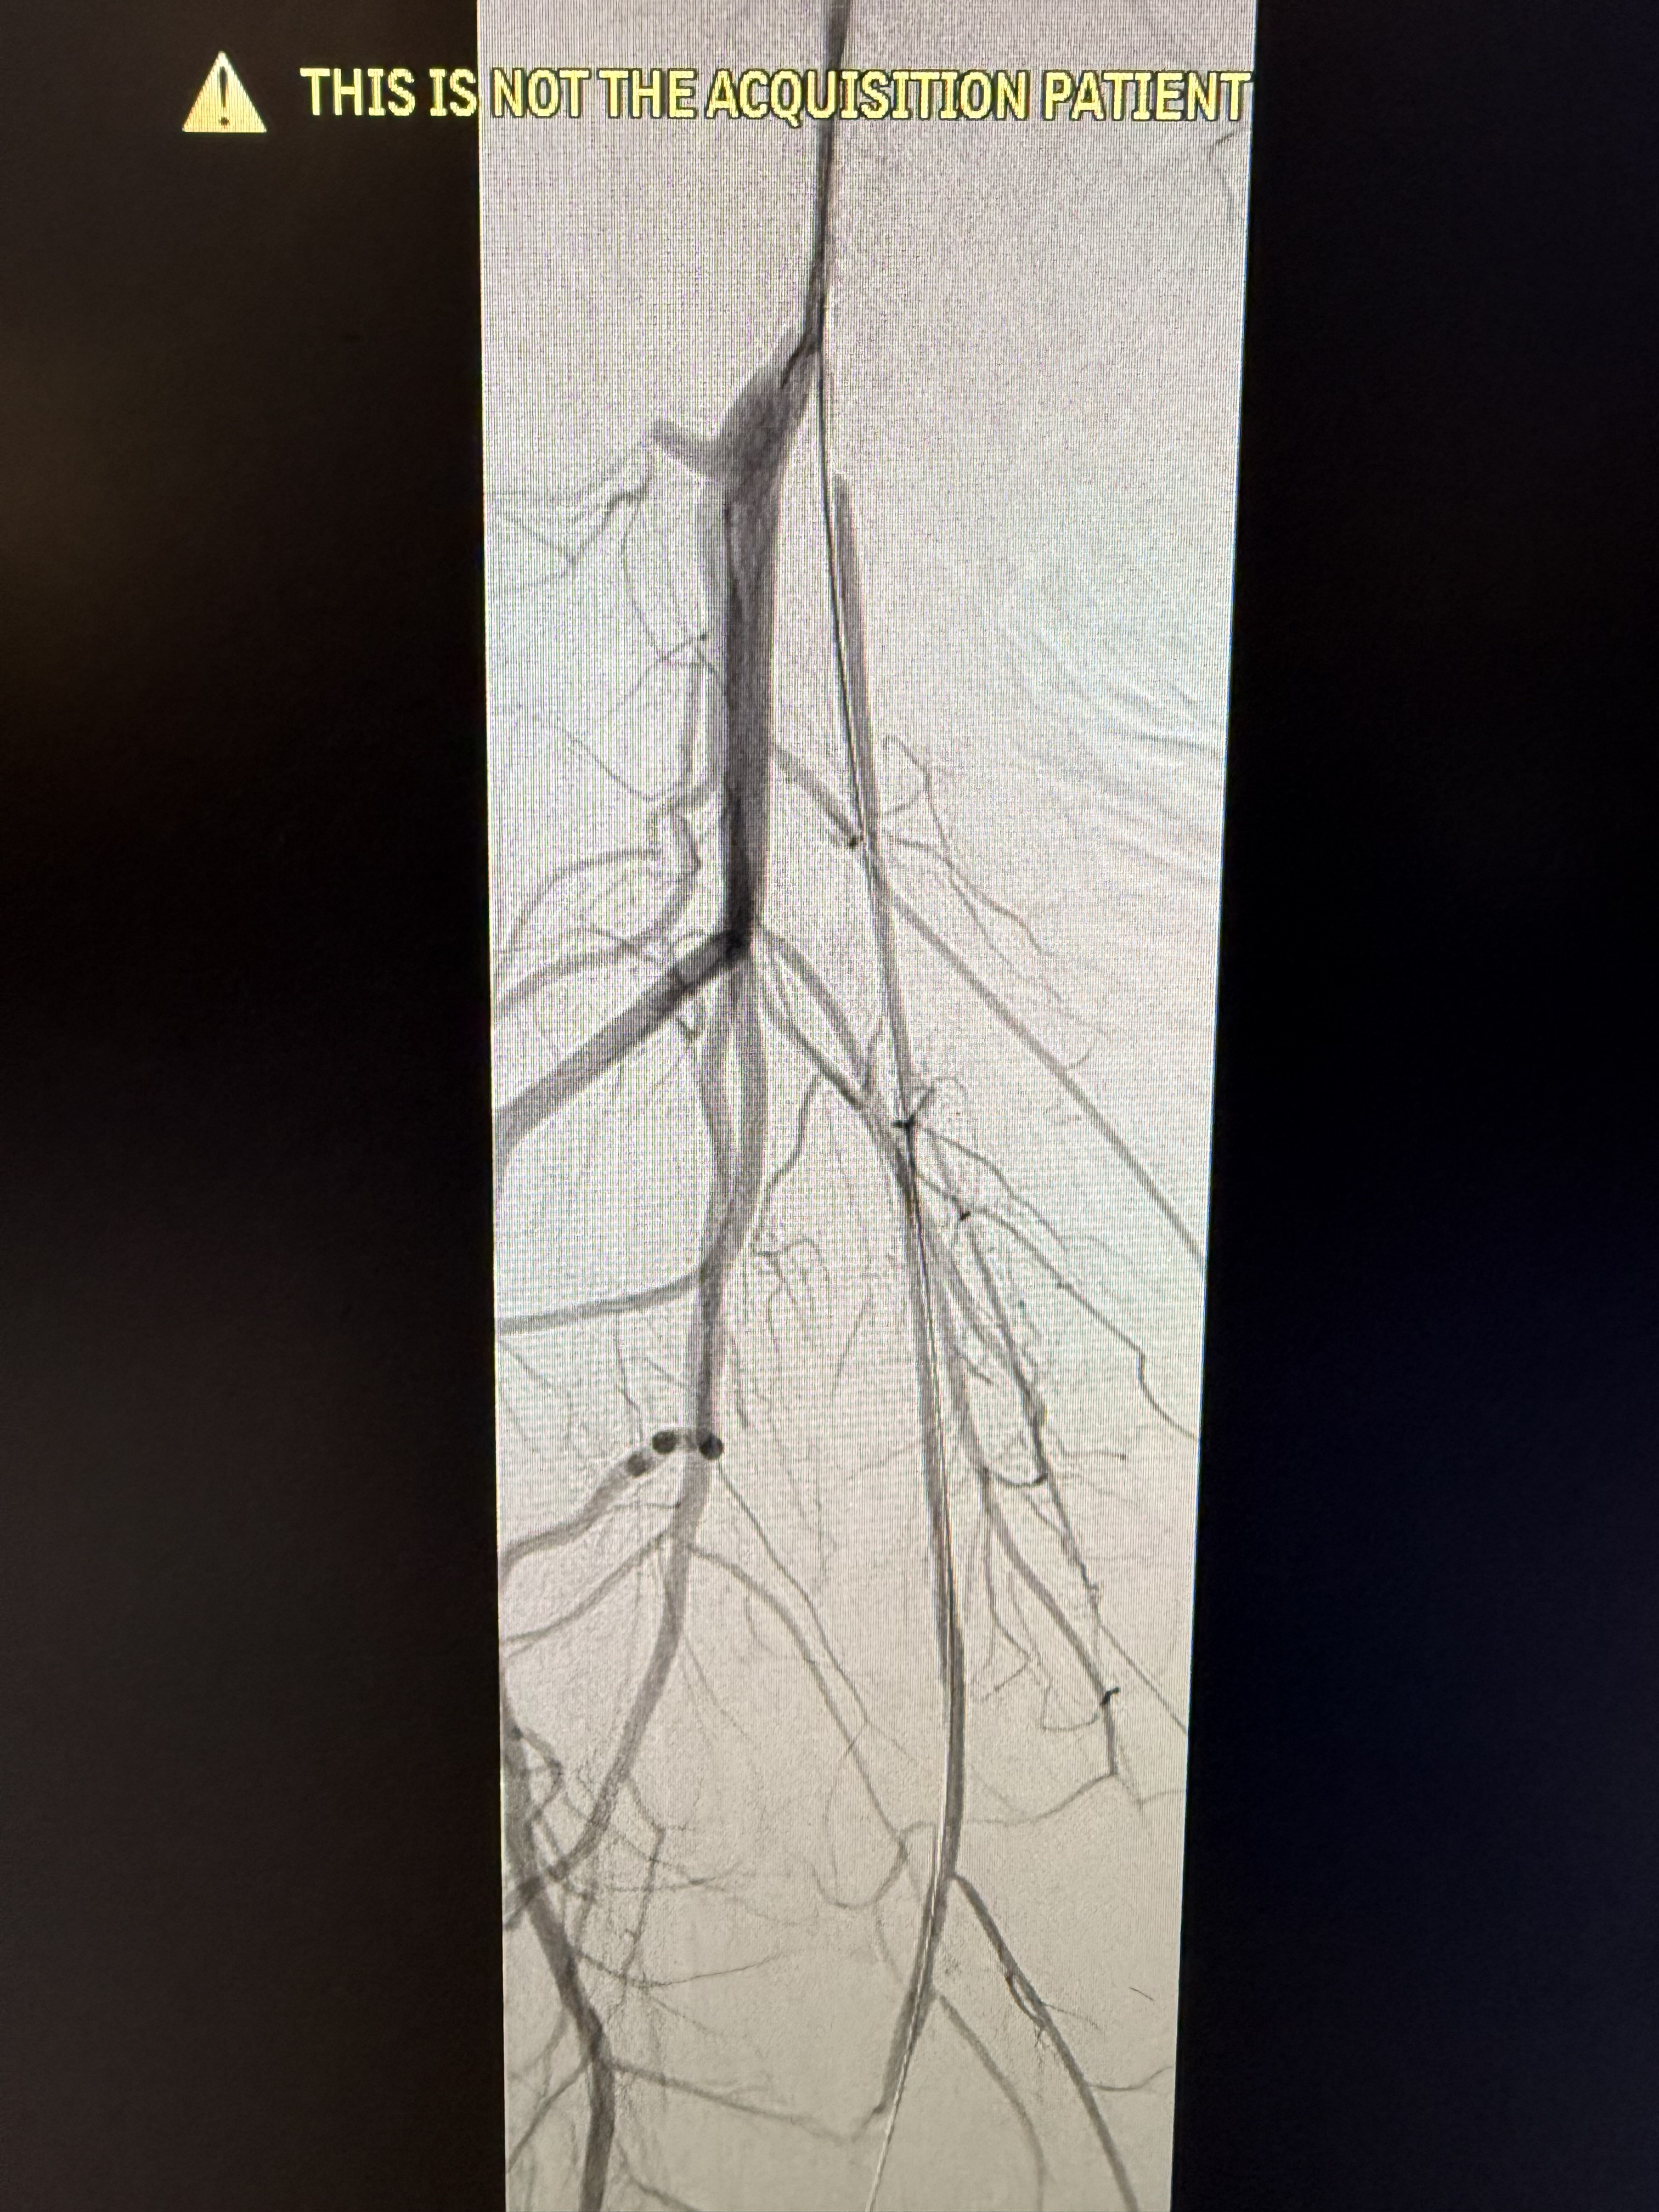
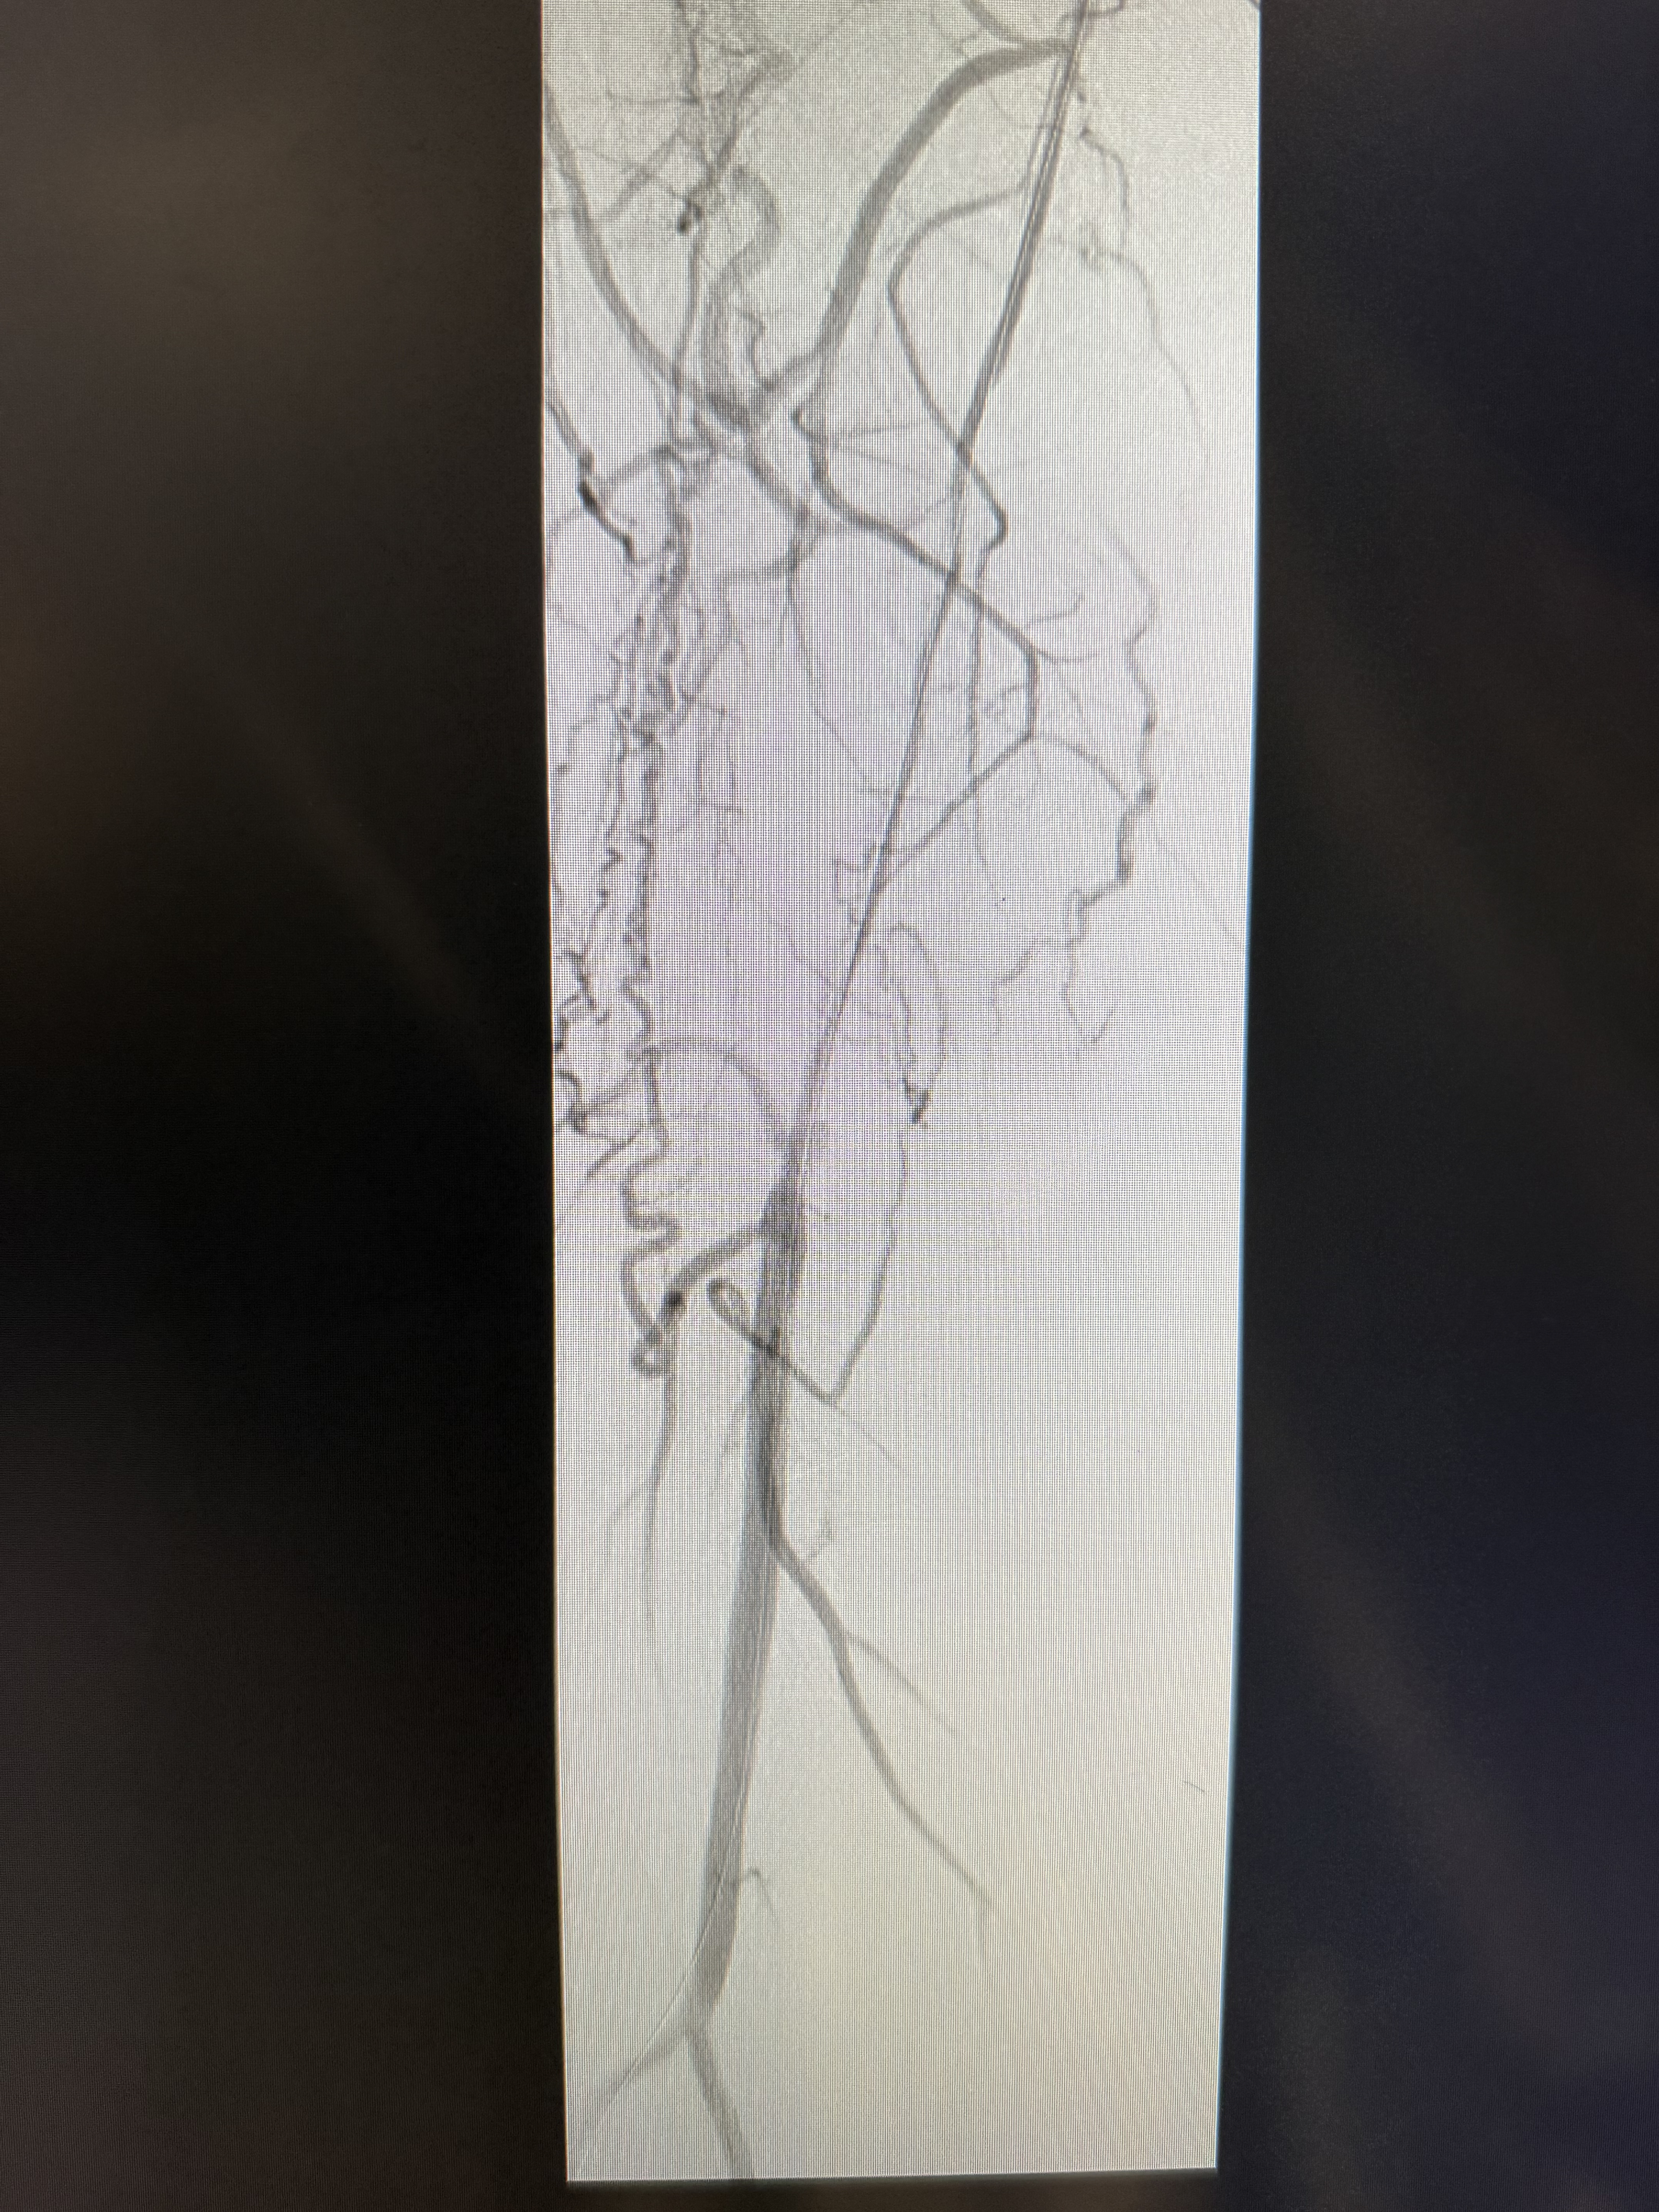
Intraprocedural Imaging
SANTREVA CROSSING
CHANNEL POST SANTREVA
Notes:
Access site and approach : LFA
6FR 45cm Terumo Sheath
Santreva and Grandslam
Santreva crossing time: 16 mins
4 x 300cm PTA, 4x300 DCB
Intra-procedural decision points
+/- support through the sheath

Slide 10
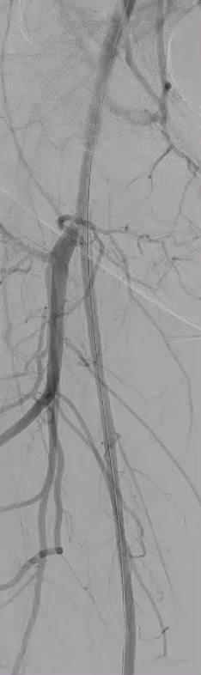


Final Result

